Slide 1
GI Lecture: Liver, Pancreatic, and Biliary Conditions
Erik Hollers, PA-C – Moffitt Cancer and Research Center
Lincoln Memorial University - Tampa
Clinical Medicine II
Summer 2026

Slide 2
Course Objectives
Explain the epidemiology, etiology, pathophysiology, clinical presentation, diagnostic findings, and treatment of Diseases of the Colon and Rectum.
Explain the epidemiology, etiology, pathophysiology, clinical presentation, diagnostic findings, and treatment of Diseases of the Anorectum including
Explain the epidemiology, etiology, pathophysiology, clinical presentation, diagnostic findings, and treatment of Diseases of the Liver
Explain the epidemiology, etiology, pathophysiology, clinical presentation, diagnostic findings, and treatment of Diseases of the Biliary Tract
Explain the epidemiology, etiology, pathophysiology, clinical presentation, diagnostic findings, and treatment of Diseases of the Pancreas

Slide 3
Course Objectives
Apply knowledge of GI anatomy and physiology when taking a patient’s history, performing a physical examination, and developing a treatment plan, considering age-related changes
Differentiate between normal and abnormal gastrointestinal exam findings to guide and support medical decisions and treatment plans.
Analyze abnormal findings to develop a relevant differential diagnosis utilizing a system based pathophysiological model.
Interpret common GI laboratory and diagnostic tests/screenings (including selection of appropriate tests and interpretation of age-appropriate reference ranges).
Select appropriate patient-centered treatment plans for gastroenterology disorders that incorporate evidence-based non-pharmacologic and pharmacologic interventions, considering patient preferences, values, and cultural beliefs.
Develop professional, culturally sensitive, empathetic, comprehensive acute and chronic care plans for patients of all ages, incorporating preventive care, education, referrals, and rehabilitation coordination.

Slide 4


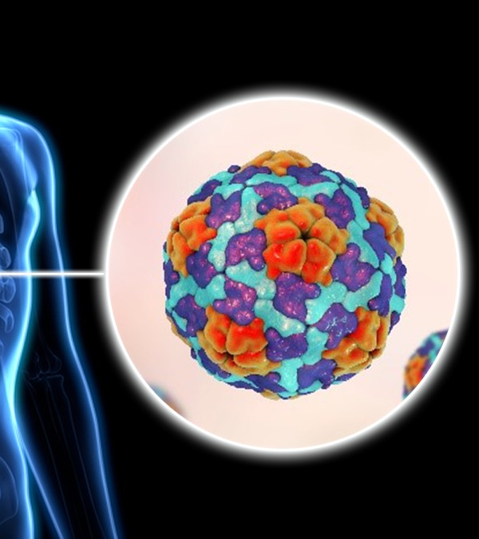
Hepatitis: overview
Hepatitis: inflammation of the liver
Multiple Etiologies Include:
Viral Infections: Hep A, B, C, D, and E
Alcohol Toxification
Drug Induced (ex. Tylenol)
Autoimmune process
All causes can cause similar sign/symptoms. It’s our job to figure out the cause and try to fix it

Slide 5
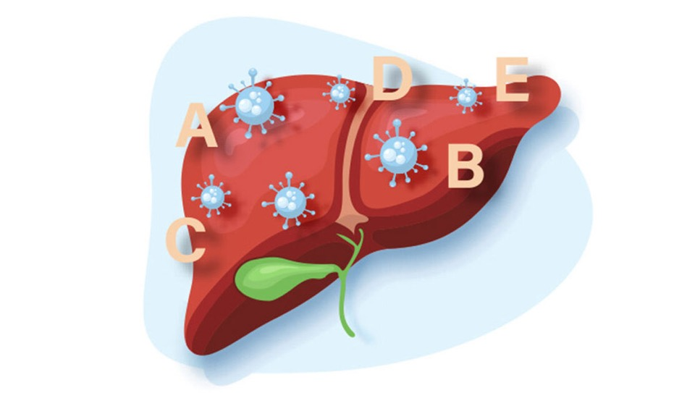
Hepatitis: Clinical Manifestations
Early Stage
Fever/Malaise (fever often associated with Hep A)
Fatigue
Anorexia
N/V/D
Abdominal Pain
Loss of Appetite
Later Stage (Fulminant Stage)
Jaundice
Encephalopathy
Coagulopathy
Hepatomegaly
Ascites
Asterixis (flapping hand tremor with wrist extension)

Slide 6
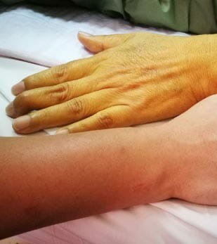
Hepatitis: Diagnostics
Transaminitis: Elevated AST/ALT (usually greater than 500 if acute, less than 500 in more chronic hepatitis)
Coagulopathy: Elevated PT/INR, PTT
Hyperbilirubinemia
Hypoglycemia (d/t decreased hepatic gluconeogenesis)
Elevated Ammonia (can lead to encephalopathy)

Slide 7
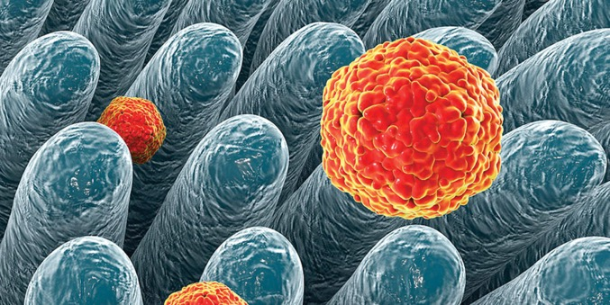
Hepatitis: Etiologies – Hep A
RNA Virus transmitted primarily via fecal oral route (person to person or cross-contamination)
Highest in developing countries
Risk Factors
IV Drug Users
Endemic Workers
Sexual relations (MWM)
Clinical Manifestations:
Most patients have mild symptoms (self limited)
Incubation Period: 28 days on average
N/V/D, Anorexia, FEVER, malaise, RUQ pain
Later Symptoms (few weeks later): dark urine (bilirubinuria), pale stools (lacking bilirubin), jaundice, pruritus. Pregnant women have high risk of pre-term/gestational complications
Diagnostics: Elevated AST/ALT (ALT usually higher, 1000s+), hyperbilirubinemia
Serological Testing: (+) IgM and anti-HAV antibodies
Treatment: Supportive care – usually resolves within a few months
HEP A VACCINE Available: 2 doses of vaccine 6-12 months apart

Slide 8
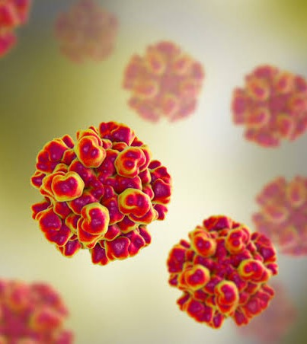
Hepatitis: Etiologies – Hep E
RNA Virus transmitted primarily through consumption of contaminated food and water
MC cause of acute viral hepatitis globally
Clinical Manifestations:
Most have self-limiting illness
Incubation period: 15-60 days
Jaundice (about 5-10 days post exposure), malaise, anorexia, n/v, abdominal pain, fever, hepatomegaly
Fulminant Hepatitis: rare (about 1-2% of cases)
Diagnostics: Elevated AST/ALT (ALT usually higher 1000+), hyperbilirubinemia
Serological Testing: (+) IgM and anti-HEV antibodies
Treatment: Supportive Care
Chronic Hepatitis can develop in immunocompromised patients

Slide 9
Hepatitis: Etiologies – Hep D
RNA Virus that requires Hepatitis B surface antigen (HBsAG) to become infectious (Hep D uses HBsAG protein to assemble/reproduce)
Infectious Hep D ALWAYS associated with Hep B Infection
Dual infection caused by Hep B/D can lead to acute liver failure/chronic hepatitis
Usually transmitted via Parenteral Route: IV drug users or blood products
Clinical Manifestations:
Co-Infection: Dual infection with Hep B (no prior exposure) and Hep D presents as acute hepatitis. Clinically non-distinguishable from acute Hep B. Typically self-limiting
Superinfection: Hep B unknown carrier with severe hepatitis with Hep D -or- exacerbation of Chronic Hep B.
Higher incidence of Liver failure/Cirrhosis
Higher risk of Hepatocellular carcinoma
Diagnostics: (+) hepatitis D Antigen (anti-HDV), (+) Serum HDV RNA,Hep B serologies, (+) IgM Hep B (co-infection ONLY), HBsAG (present in both co-infection and superinfection)
Management:
Pegylated Interferon Alpha 2b: can eliminate Hep D RNA in approximately 20-50% (has a lot of side effects)
For Liver Failure/Cirrhosis: will need liver transplant

Slide 10
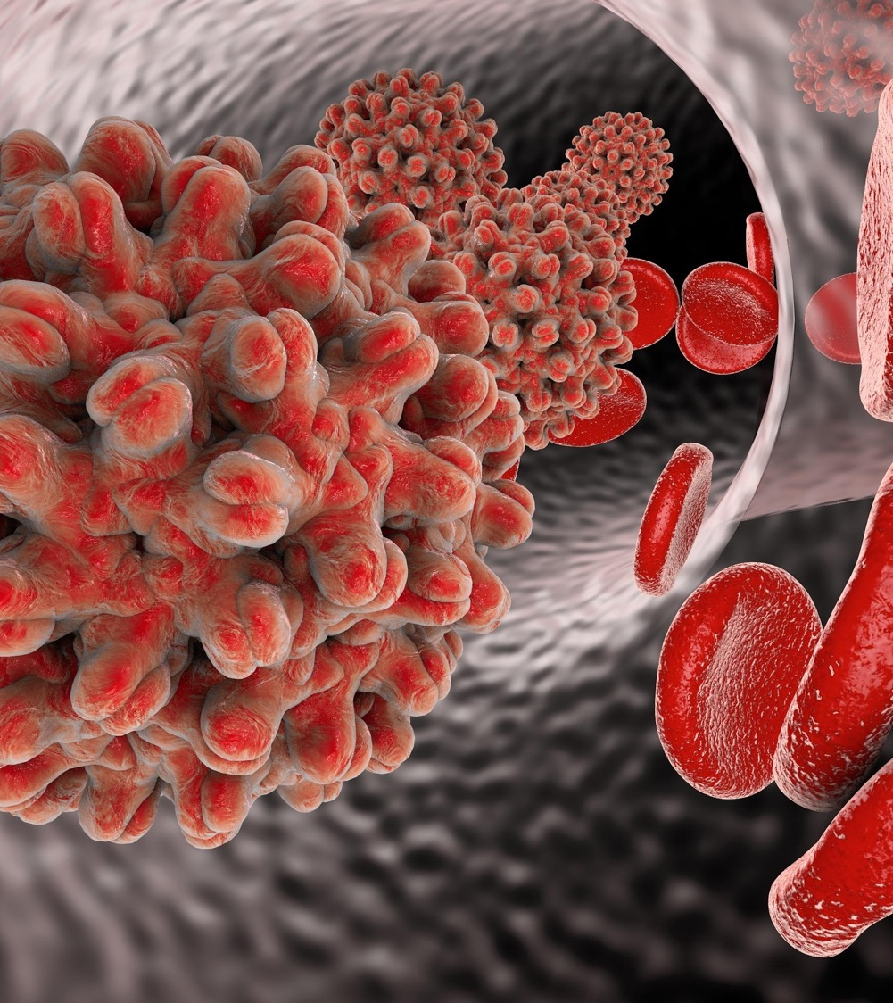
Hepatitis: Etiologies – Hep B
DNA Virus transmitted via: percutaneous, sexual, parenteral, perinatal (childbirth)
Clinical Manifestations: malaise, fatigue, arthralgia, n/v/d, abdominal pain, jaundice (only in about 1/3 patients), dark urine, pale stools
Can lead to fulminant phase – liver failure
Presents in both acute and chronic phases
Diagnostics: this is the fun part!

Slide 11
Hepatitis: Etiologies – Hep B
Diagnostics:
Elevated AST/ALT (1000s in acute, 100s if chronic)
Hyperbilirubinemia
+ HBV DNA
Serologies:
Hep B Surface Antigen (HBsAG)
Hep B Surface Antibody (anti-HBs)
Hep B Core Antibody (anti-HBc)
Hep B Core Antigen not detectable
Hep B E Antigen (HBeAG)
Hep B E Antibody (Anti-HBe)
Diagnosis | HBsAG | anti-HBs | anti-HBc | HBeAG | anti-HBe
Window Period | - | - | IgM | - | -
Acute Hepatitis | + | - | IgM | +/- | +/-
Resolved | - | + | IgG | - | -
Immunization | - | + | - | - | -
Chronic Hepatitis (replicative) | + | - | IgG | + | -
Chronic Hepatitis (non-replicative) | + | - | IgG | - | +

Slide 12

Hepatitis: Etiologies – Hep B
Management:
Supportive care: most patients do not progress to chronic hepatitis
Antiviral therapy: based persistent/severity of symptoms, sever hyperbilirubinemia (bilirubin>10), severe transaminitis, HBeAG persistence
Entecavir and Tenofovir (first line)
Alternates: Adefovir, Telbivudine, and Lamivudine
Treatment continues until clearance of HBsAG
Hep B Vaccine available: usually given in with childhood vaccinations

Slide 13
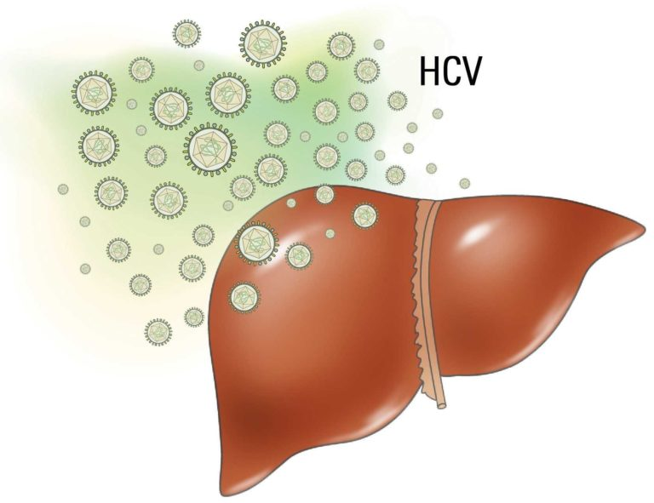
Hepatitis C: Overview
Hepatitis C: single stranded RNA virus
MC cause of chronic liver disease, cirrhosis (leading to liver transplant) ‘
MC cause of transmission: IV Drug Usage (other causes: sexual transmission and mother-neonatal transmission)
Chronic Hepatitis: can occur in as high as 85% of patients with acute hepatitis C. This eventually leads to liver cirrhosis and increased risk for hepatocellular carcinoma.

Slide 14
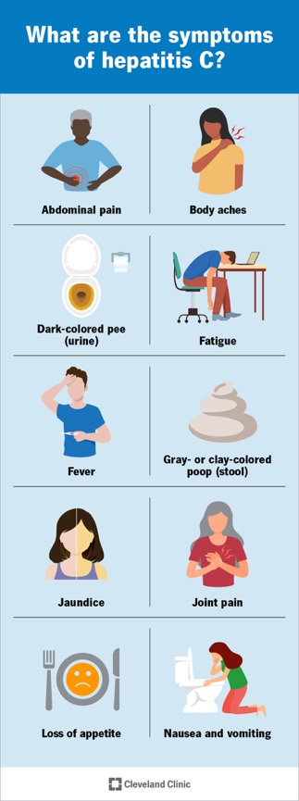
Hep C: Clinical Manifestations
Incubation period: 6-7 weeks
Most patients remain asymptomatic until signs/symptoms of liver cirrhosis begin to occur (ascites (why?), esophageal varices, portal HTN)
Acute Hepatitis Symptoms: fatigue, malaise, RUQ pain, jaundice, clary-colored stools

Slide 15

Hep C: Clinical Manifestations
Diagnostics:
CMP: LFTs elevated (waxing and waning)
CBC with diff
PT/PTT/INR/Fibrinogen
HCV antibodies: indicates acute vs chronic (+ result within 6 weeks)
Anti-HCV without HCV RNA = past recovery from HCV
Anti-HCV with HCV RNA = likely Chronic Hepatitis

Slide 16
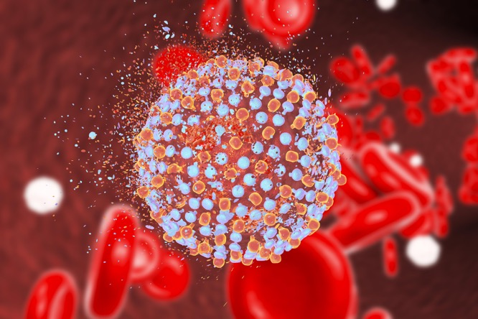
Hep C: Management
Oral Regimens first line: high potential for cure rate
Glecaprevie-Pibrentasvir for 8 weeks
Sofosbuvir-Velpatasvir for 12 weeks
Treatment options have the potential to reactivate Hep B (always check first)
Re-check HCV Viral Levels around 3 months after finishing oral regimen
For patients with signs/symptoms of cirrhosis – close monitoring warranted for complications including future malignancy.

Slide 17
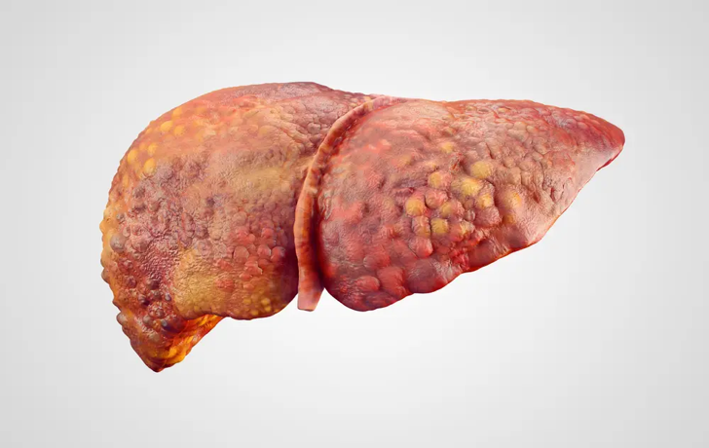
Cirrhosis: Overview
Cirrhosis: represents a late stage of progressive hepatic fibrosis characterized by distortion of the hepatic architecture and the formation of regenerative nodules.
Can lead to Portal Hypertension due to hepatic cell dysfunction and portosystemic shunting.
Etiologies: Chronic Hepatitis (Hep C) MC, alcohol, Chronic HBV, HDV.
Others: Fatty Liver Disease, Medication Induced, Autoimmune hepatitis, biliary cirrhosis

Slide 18
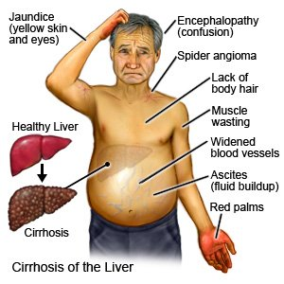
Cirrhosis: Clinical Manifestations
Symptoms: dependent on extent of disease/complications
General symptoms: fatigue, weakness, weight loss, abdominal pain
GI Bleed: due to portal HTN/esophageal varices, peptic ulcers
Physical Exam:
Ascites (WHY?)
Skin Changes: spider angioma, telangiectasia
Hepatosplenomegaly
Gynecomastia (hormone imbalance – liver clears estrogen)
Muscle Wasting
Jaundice
Symptoms of hepatic encephalopathy (more on this)

Slide 19
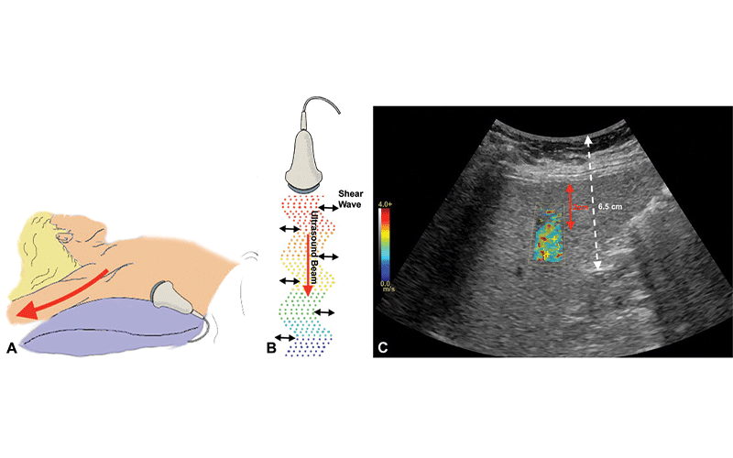
Cirrhosis: Clinical Manifestations
Diagnostics:
US RUQ/Abd: fibrosis nodularity with increased echogenicity atrophy or hypertrophy of live
Elastography: measures stiffness of the liver – increased stiffness in cirrhosis
Liver biopsy: definitive diagnosis
CMP: elevated LFTs, Hyperbilirubinemia
Coagulations Studies

Slide 20
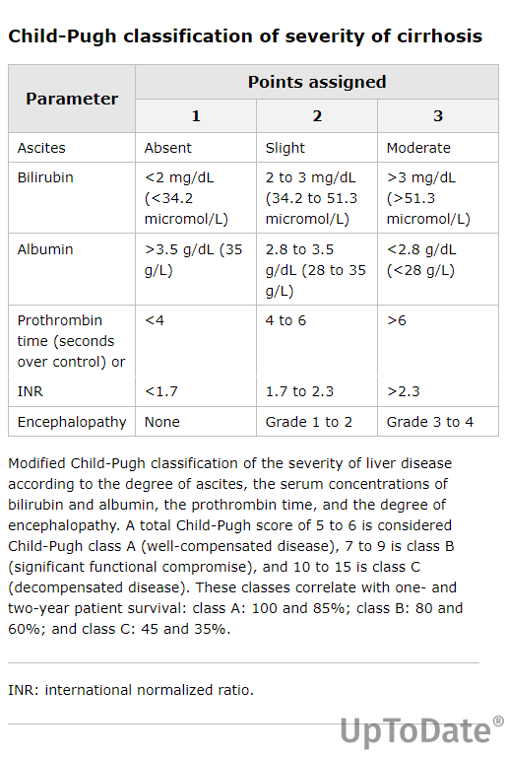

Slide 21
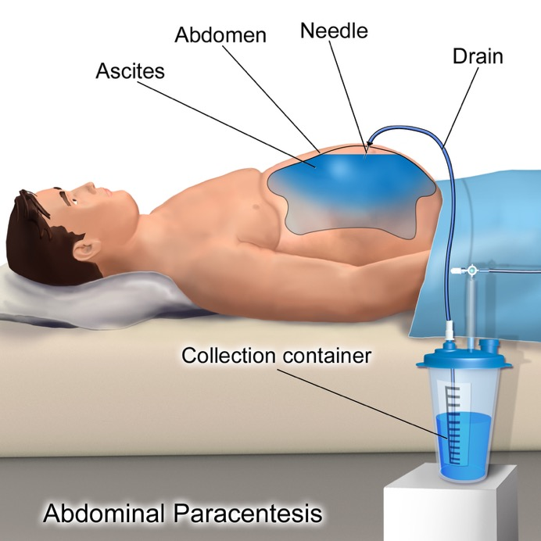
Cirrhosis: Management
Survival rates vary on class of Cirrhosis
Class A: 100% 1-year, 85% 2-year
Class B: 81% 1-year, 57% 2-year
Class C: 45% 1-year, 35% 2-year
Restriction: alcohol, hepatotoxic meds, sodium
Treat Ascites/Edema: limit sodium, diuretics (Spironolactone/Lasix), may require paracentesis intermittently
Pruritus: Cholestyramine (bile acid sequestrant)
Monitor closely for GIB/Bleeding
LIVER TRANSPANT = ULTIMATE CURE

Slide 22
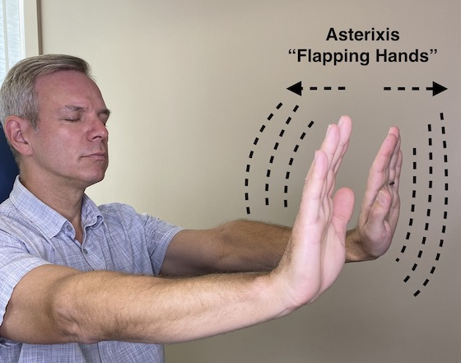
Hepatic Encephalopathy
Hepatic Encephalopathy: neuropsychiatric abnormalities resulting from the liver’s failure to detoxify agents of gut origin (ammonia) due to hepatocellular dysfunction and/or portosystemic shunting.
Clinical Manifestations:
CNS Symptoms: confusion, drowsiness, stupor, coma
PE: asterixis (flapping tremor with wrist extension) and fetor hepaticus (foul breath)

Slide 23
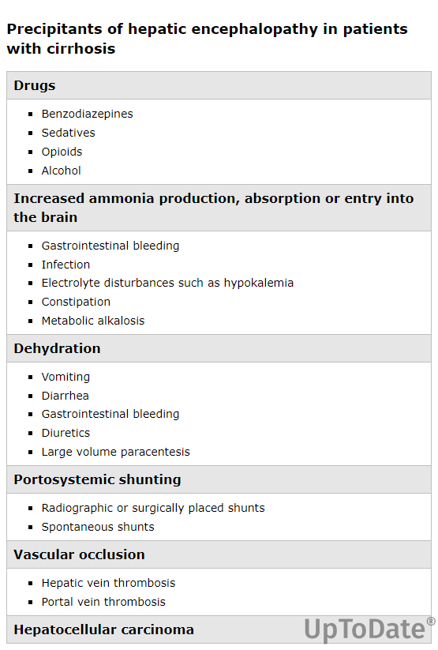

Slide 24
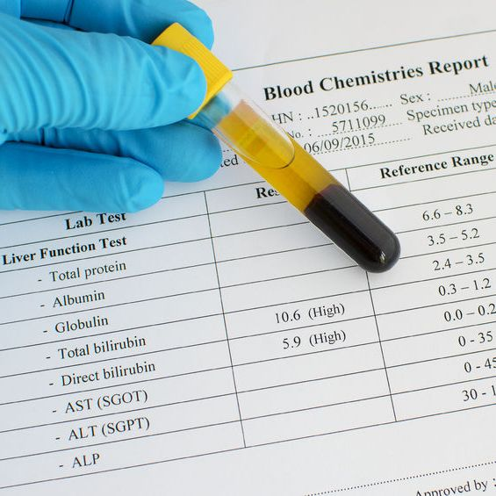
Hepatic Encephalopathy
Diagnostics:
CBC with diff (WHY?)
CMP: elevated LFTs, hyperbilirubinemia, low albumin
Ammonia levels
Assess Kidney Function (WHY?)
Urine Drug Screen
Coagulation Studies
Lactic Acid/Procalcitonin/Blood cultures
Consider CT Head (WHY?)
Abd Ultrasound

Slide 25
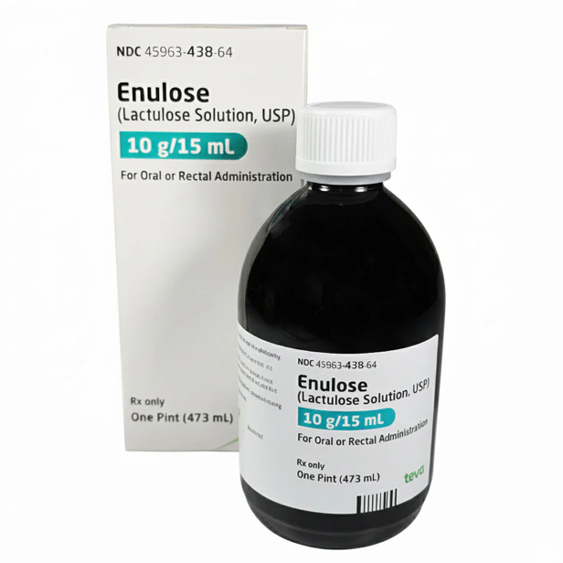
Hepatic Encephalopathy: Management
Lactulose or Lactitol: first line for lowering Ammonia levels – bacterial flora converts lactulose into lactic and fatty acids which neutralizes Ammonia
Rifaximin: alternative for patients who do not tolerate lactulose
Nutritional/electrolytes supplementation
Hydration
Monitor closely for recurrence and must rule out infection

Slide 26
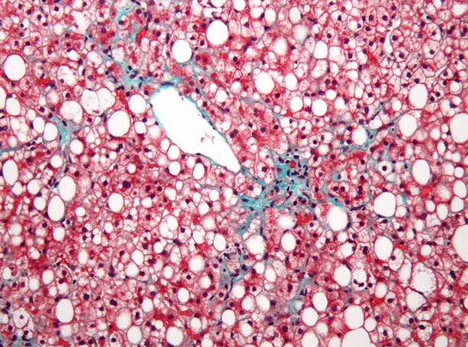
Non-Alcoholic Fatty Liver Disease
NAFLD: common cause of abnormal liver function tests
Etiologies: OBESITY MC, DM, HLD (high triglycerides), steroid usage
Most patients are asymptomatic but 75% have hepatomegaly
2 Types:
Nonalcoholic Fatty Liver: accumulation of triglycerides within hepatocytes – inhibits normal function
Nonalcoholic Steatohepatitis (NASH): liver cell injury and death, inflammation – can lead to fibrosis and eventual cirrhosis
Also can be referred to as MASH (metabolic associated steatohepatitis)

Slide 27
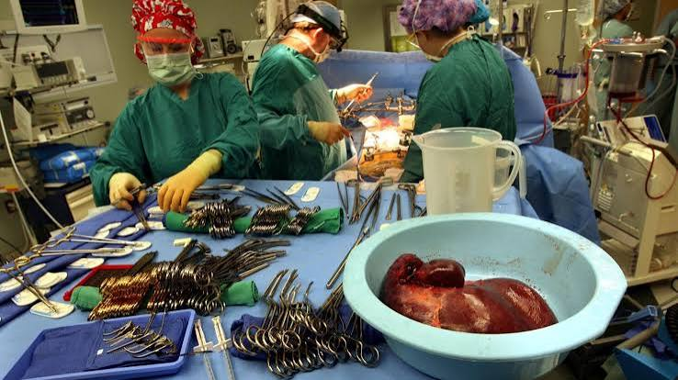
Non-Alcoholic Fatty Liver Disease
Diagnostics:
CMP/Coagulation studies/Ammonia
Liver Biopsy: definitive diagnosis – micro-vesicular fatty deposits
Management:
Lifestyle modification: weight loss, fat restriction, diet/exercise
May need liver transplant if cirrhosis occurs
Medical Management: reserved for patients with stage 2 or greater fibrosis
GLP-1 Based Therapies: Semaglutide, Tirzepatide, Liraglutide
Resmeritom: alternative for stage 2 or 3 fibrosis who do not tolerate GLP-1 – thyroid receptor beta agonist that helps reduce liver fat and inflammation
ION224: investigational monthly injection that blocks DGAT2 liver enzyme – stops internal fat production and inflammation (currently being studied)

Slide 28
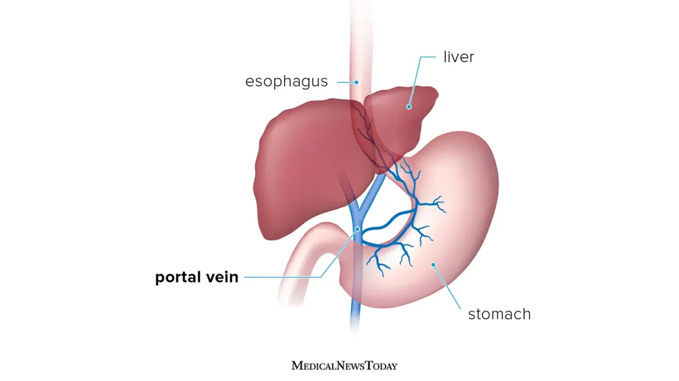
Portal Hypertension: Overview
Portal Hypertension: increased blood pressure in the portal vein system
Portal HTN develops when there is resistance to portal blood flow and is aggravated by increased collateral blood flow
Etiologies: MC Cirrhosis of the liver, portal vein thrombosis
In other countries: Schistosomiasis (parasitic infection)

Slide 29
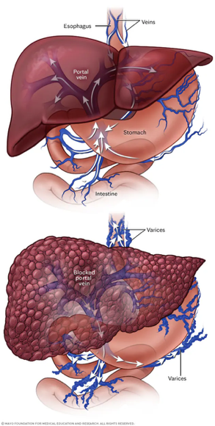
Portal Hypertension: Clinical Manifestations
Most patients are asymptomatic until complications occur
Sign/Symptoms
Hepatosplenomegaly
Ascites
Jaundice
Abdominal Distention
Complications: variceal hemorrhage, portal hypertensive gastropathy, hepatic encephalopathy, spontaneous bacterial peritonitis, hepatorenal syndrome, hepatopulmonary syndrome, portal cholangiopathy

Slide 30
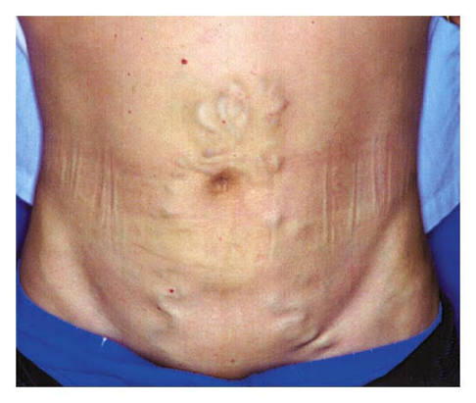
Portal Hypertension: Clinical Manifestations
ABCDE: Classic Portal Hypertension
Ascites
Bleeding: Hematemesis/Piles
Caput Medusae (swollen veins from the belly button across abdomen)
Diminished Liver – Atrophy
Enlarged Spleen (Splenomegaly) (back up into spleen)

Slide 31
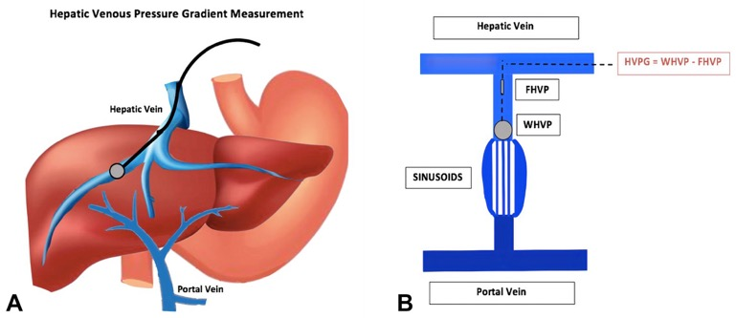
Portal Hypertension: Clinical Manifestations
Portal Hypertension can often be diagnosed clinically
Hepatic Venous Pressure Gradient (HVPG): measures the pressure between the portal vein and the inferior vena cava (normal: 1-5 mmHg)
Typically becomes clinically significant if HPVG>10 mmHg
US w/Elastography: measures stiffness of the liver and can look for any other acute issues with the liver/biliary tract

Slide 32
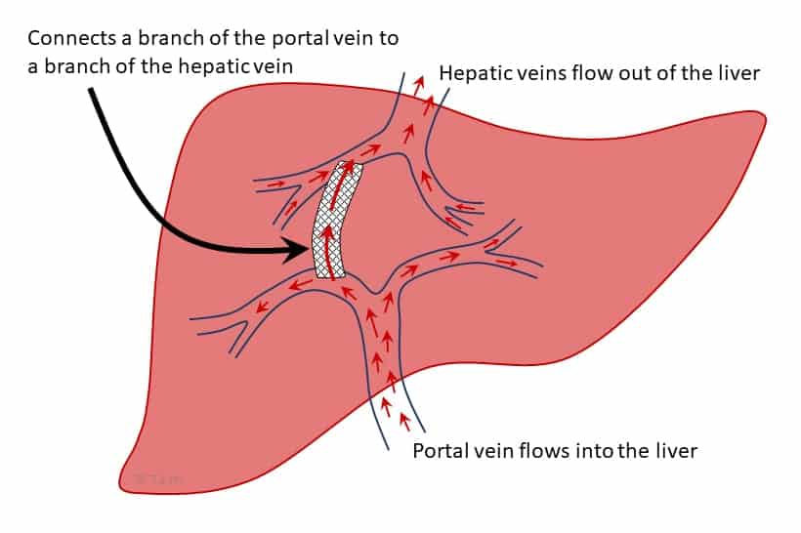
Portal Hypertension: Management
Treatment of Portal Hypertension typically involves management of the complications (varices, encephalopathy etc.)
Sodium/Salt Restriction
Diuretics (Spironolactone, Lasix)
May require intermittent paracentesis
Beta Blockers: Carvedilol, Propranolol, Nadolol
TIPS (Trans jugular Intrahepatic Portosystemic Shunt: placement of a shunt between veins to help relieve pressure on portal vein

Slide 33
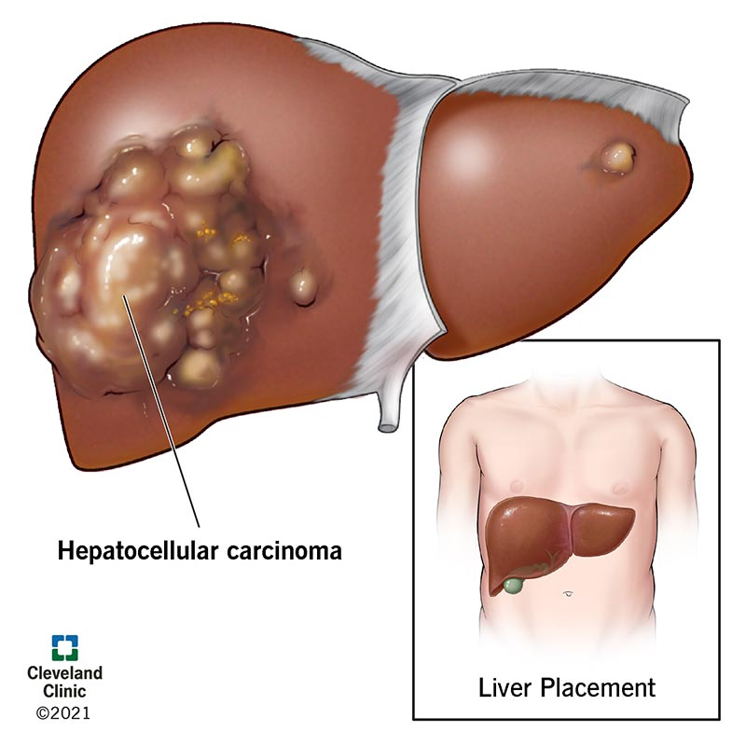
Hepatocellular Carcinoma: Overview
Hepatocellular Carcinoma: primary neoplasm (malignancy) of the liver (MC primary liver cancer)
Risk Factors: Cirrhosis MC (macronodular) and other associated chronic liver disease (HBV, HCV, HDV etc.), alcoholic liver disease, men slightly higher risk
Chronic hepatic inflammation leads to fibrosis which progresses to cirrhosis of the liver. Eventually, causes chronic damage to cells leading to dysplasia and possible malignancy further down the road.

Slide 34
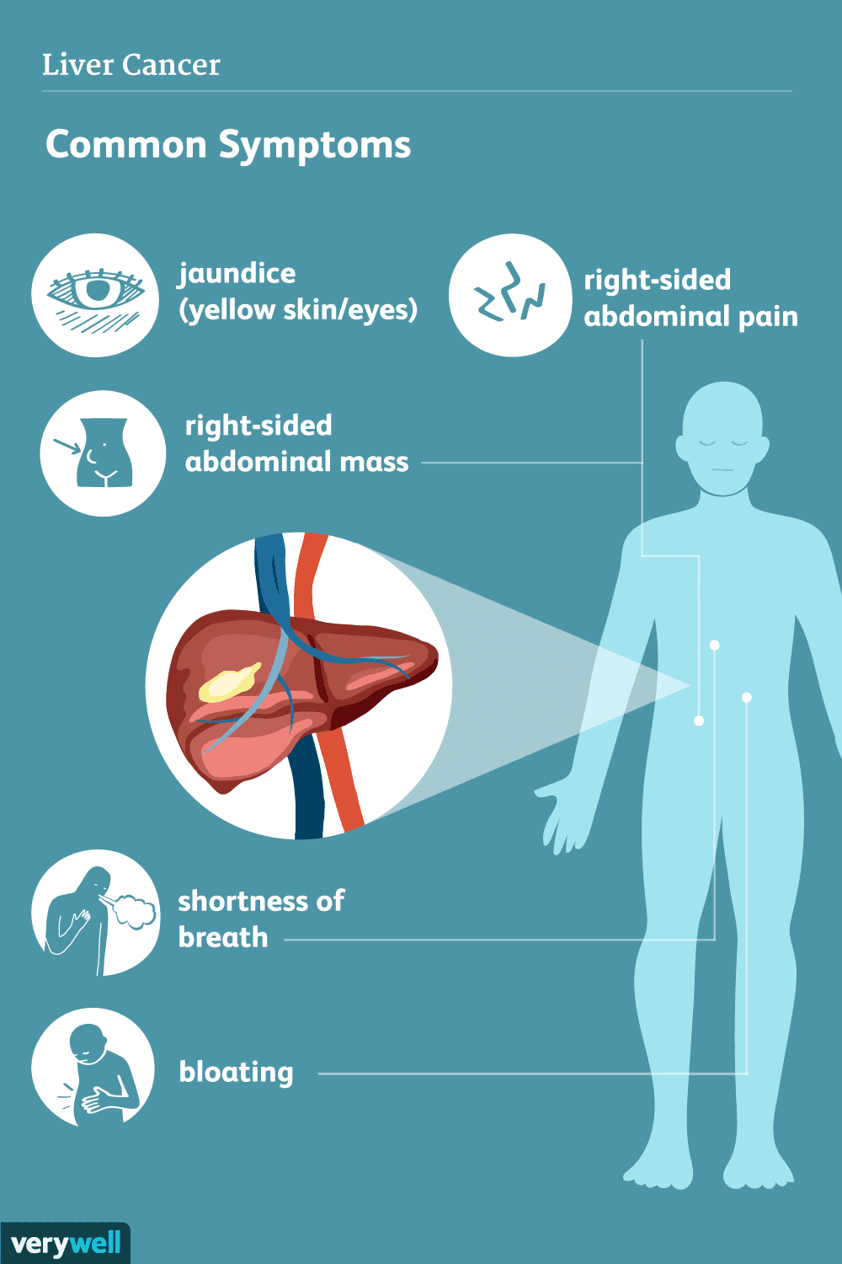
Hepatocellular Carcinoma: Clinical Manifestations
Sign/Symptoms: most are asymptomatic until disease more progressive and/or metastasis occurs.
Malaise/Weight Loss
Jaundice (WHY?)
Abdominal Pain
Hepatosplenomegaly
Ascites

Slide 35
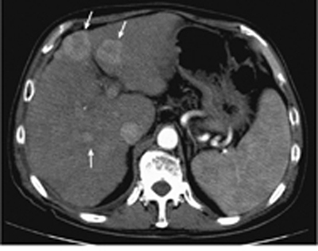
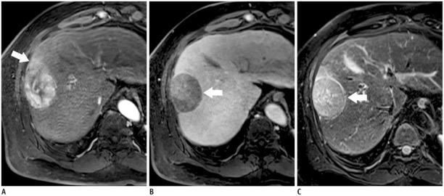
Hepatocellular Carcinoma: Clinical Manifestations
Diagnosis can be determined based on imaging alone in some cases.
For patient who are high risk (cirrhosis, HBV hx) = screening
US Abd (liver): every 6 months looking for liver lesions.
If US shows lesions <1cm = ongoing surveillance every 3-6 months
If US shows lesions >1cm = CT A/P w/contrast or MRI w/wo Contrast Abd (shows arterial enhancement with veinous washout)
Biopsy typically not required in patients who are at high risk for HCC with imaging criteria

Slide 36
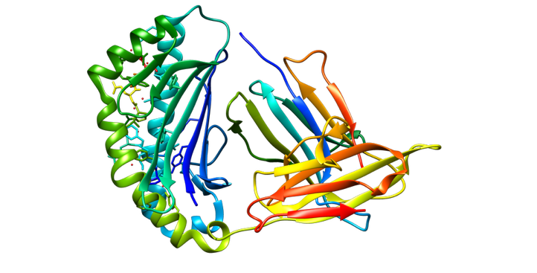
Hepatocellular Carcinoma: Clinical Manifestations
Alpha-Fetoprotein (AFP): increased serum levels can be used to aid in diagnosis.
However, AFP (and most tumor markers for that matter), are non-specific meaning they don’t directly correlate with the specific malignancy.
AFP can aid with surveillance during treatment process (increasing/decreasing can direct therapies moving forward)
Liver Biopsy: definitive diagnosis (only for some patients – when diagnosis is not conclusive)

Slide 37
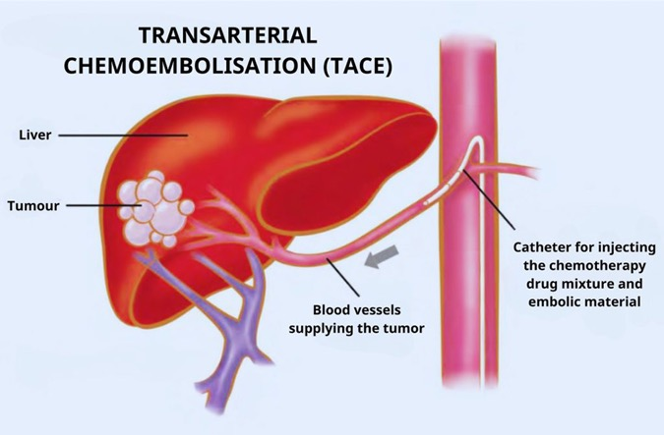
Hepatocellular Carcinoma: Management
Surgery: resection reserved for patients who do not have cirrhosis and where tumors are confined to one lobe.
Liver Transplant: potential curative options, but patients must meet certain criteria. Downside, patient will need donor and can’t have disease progression while waiting for transplant.
Patients in early stages/limited disease: radiofrequency ablation or microwave ablation
Intermediate Disease patients: consider Transarterial chemoablation (TACE) – directly administers chemotherapy to tumor region and also attempts to cut off blood supply to tumor

Slide 38

Hepatocellular Carcinoma: Management
For patients with progressive disease/distance metastasis: will need to proceed with systemic chemotherapy/immunotherapy +/- radiation
PET/CT scan required to monitor for metastasis
1st line regimen: Atezolizumab + Bevacizumab, Durvalumab + Tremelimumab, or Ipilimumab + Nivolumab
Other options: Lenvatinib or Sorafenib for patients who can’t tolerate immunotherapy
CAUTION: when starting Atezolizumab + Bevacizumab, you MUST screen for esophageal varices cause due to increased bleeding risk

Slide 39
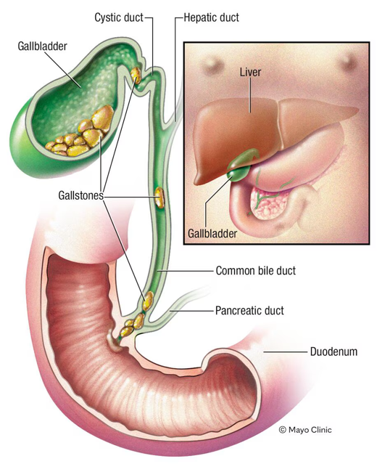
Biliary Disease: Cholelithiasis
Cholelithiasis: presence of gallstones in the biliary tract without any signs/symptoms of inflammation
Types of Gallstones:
Cholesterol: MC type (90%)
Black Stones: due to hemolysis or alcohol driven liver disease
Brown Stones: parasitic for bacterial infections (more common in Asian populations)
Risk Factors: female, pregnancy, age, HLD, OCPs, Native Americans descent, DM, HRT
Protective Factors: poly and monounsaturated fats and nuts, Coffee, vegetable protein, increased physical activity, statin usage

Slide 40
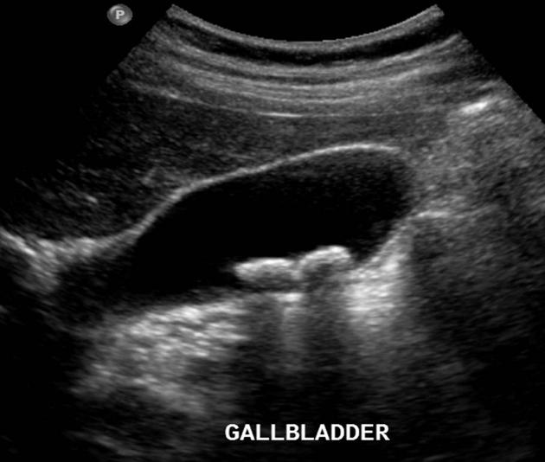
Biliary Disease: Cholelithiasis
Clinical Manifestations:
Majority of patients with gallstones are asymptomatic
Biliary Colic: episodes of RUQ or epigastric pain (with radiation to the right shoulder blade) lasting about 30 mins to a few hours. Can also have nausea and or diaphoresis. Sometimes caused after eating a large/fatty meal
Diagnostics: CBC with diff and CMP (WHY?), amylase/lipase
US Abd/Liver: 1st diagnostic choice! – appear as echogenic foci

Slide 41
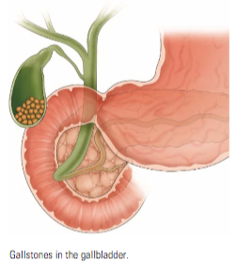
Biliary Disease: Cholelithiasis
Management:
Gallstones are often found incidentally in patient who are asymptomatic – monitor
For patients with typical biliary colic symptoms – Cholecystectomy usually recommended
If the patient doesn’t wish to have surgery, must be educated thoroughly on the potential complications of having gallstones (which we will discuss)

Slide 42
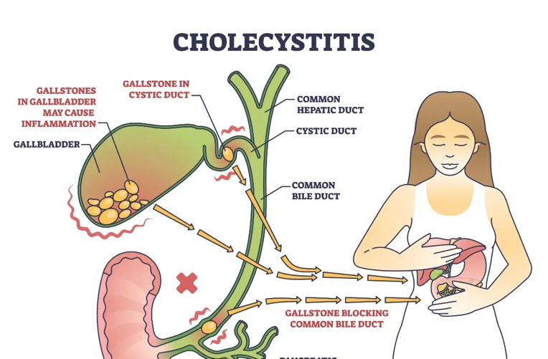
Biliary Disease: Cholecystitis
Cholecystitis: inflammation of the gallbladder often caused by gallstones +/- infectious process
Gallstones block bile from leaving the gallbladder, but an infection can also propagate in the gallbladder fluid (bile)
Gram – enteric organisms (E. Coli MC, klebsiella, Enterobacter)
Develops in around 6-11% of patients with history of gallstones

Slide 43
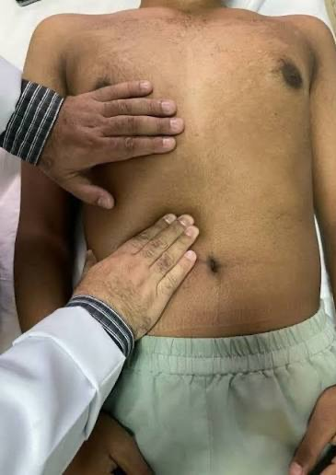
Biliary Disease: Cholecystitis
Clinical Manifestations:
Acute Cholecystitis: syndrome of RUQ pain, fever, leukocytosis
Chronic Cholecystitis: term used to describe the chronic inflammation of the gallbladder seen on histopathology
Associated with gallstones that causes mechanical irritation leading to fibrosis and thickening of the gallbladder
Symptoms: Abd pain (RUQ or epigastric), fever, n/v, anorexia
PE: fever, tachycardia, + MURPHY SIGN, palpable gallbladder, + Boas sign (referred pain to the right shoulder/subscapular area)

Slide 44
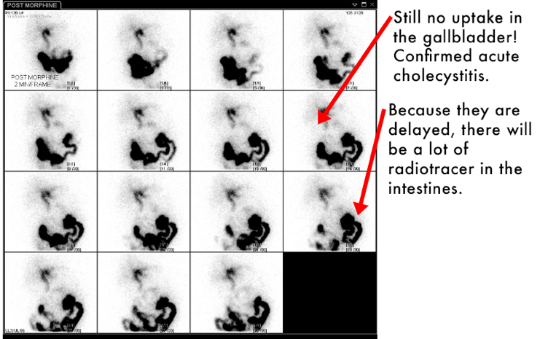
Biliary Disease: Cholecystitis
Diagnostics:
CBC with Diff (WHY?)
CMP (LFTs)
Amylase/Lipase
Lactic Acid
Pregnancy Test!
Blood cultures (x2)
Abd US: initial 1st choice: shows gallbladder wall thickening or edema, gallbladder distention, presence of stones, + Murphy Sign
Radionuclide Cholescintigraphy (HIDA scan): used if the diagnosis is unclear, nonvisualization of the gallbladder due to a stone blocking the cystic duct

Slide 45
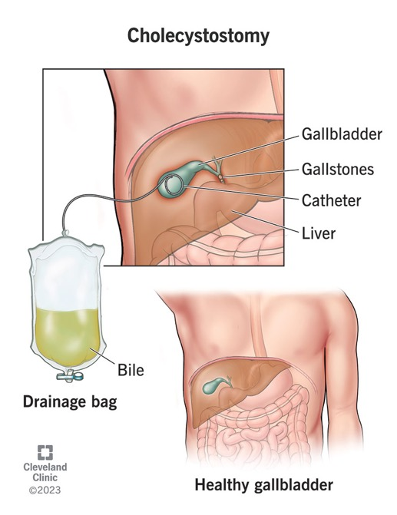
Biliary Disease: Cholecystitis
Management:
IVF, electrolyte correction, pain control (NSIADS), antiemetics
PANC (WHY?)
Antibiotics (must assume infectious): Flagyl + Cephalosporin (Ceftriaxone, Cefazoline etc.). High risk patients: Zosyn vs Meropenem
Cholecystectomy preferred within 72 hours (ideally laparoscopic)
Emergent considerations if concern for perforation or gangrene (necrosis) – WATCH OUT for hemodynamic instability
In high surgical risk patients: gallbladder drainage via percutaneous cholecystostomy

Slide 46
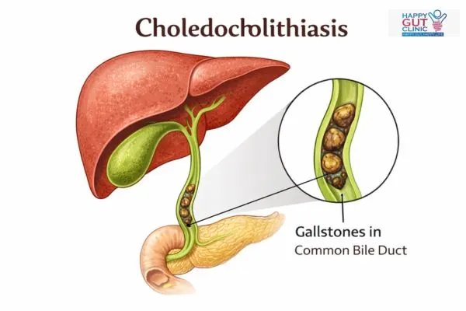
Biliary Disease: Choledocholithiasis
Choledocholithiasis: presence of gallstones in the common bile duct that have the potential to cause a blockage
Potentially cause pancreatitis or cholangitis
Risk Factors: hx of gallstones, female, pregnancy, age, HLD
Should always be considered in patients who are symptomatic with history of gallstones

Slide 47
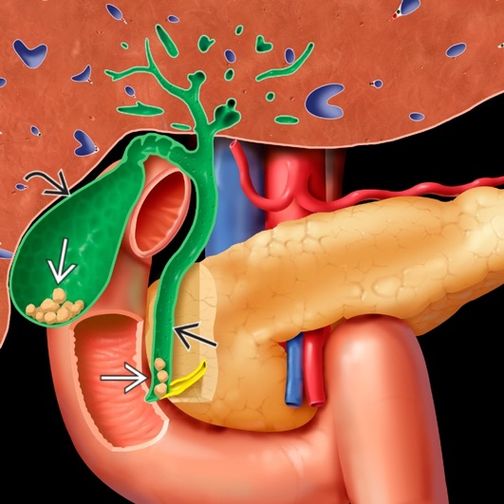
Biliary Disease: Choledocholithiasis
Clinical Manifestations:
Prolonged Biliary Colic: RUQ/Epigastric pain that sustains over 6 hours, sometime with N/V, anorexia
PE: RUQ or epigastric tenderness, Jaundice (sometimes, why?)
Diagnostics:
CBC with diff
CMP: elevated AST/ALT, Cholestatic pattern (elevated ALP + GGT – gamma glutamyl transpeptidase)
Amylase/Lipase
Abd US: dilate common bile duct
ERCP (Endoscopic Retrograde Cholangiopancreatography): Diagnostic of CHOICE!
MRCP (Magnetic Resonance Cholangiopancreatography): alternative to look at biliary tract (less invasive)

Slide 48
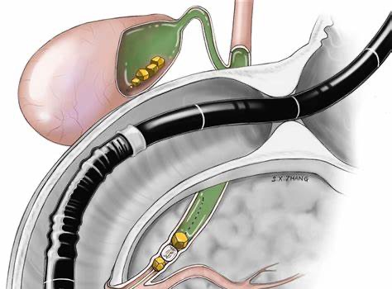
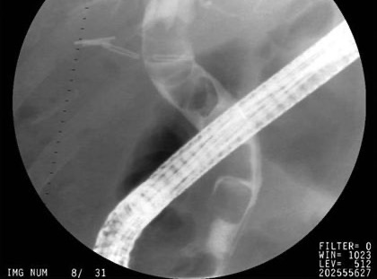
Biliary Disease: Choledocholithiasis
Management:
ERCP is the preferred treatment (is both diagnostic and therapeutic)
Can consider cholecystectomy as well
If complications from gallstone (cholangitis/pancreatitis), additional treatment may be required.

Slide 49
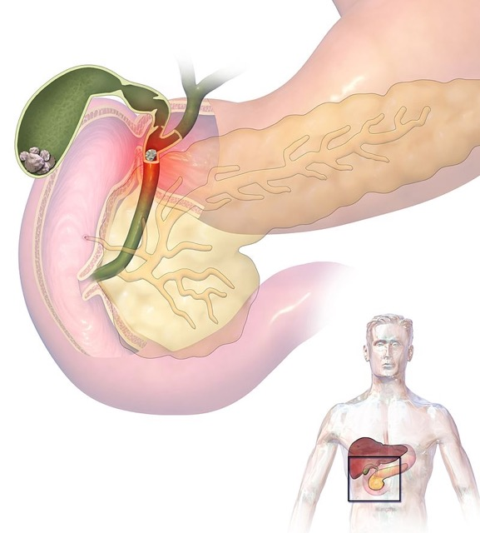
Biliary Disease: Ascending Cholangitis
Cholangitis: biliary tract inflammation and infection due to obstruction of the common bile duct.
Infectious process: MC from Gram negative organisms (E. Coli MC, Klebsiella etc.)
Other causes: malignancy (tumor, parasites, tapeworms)

Slide 50
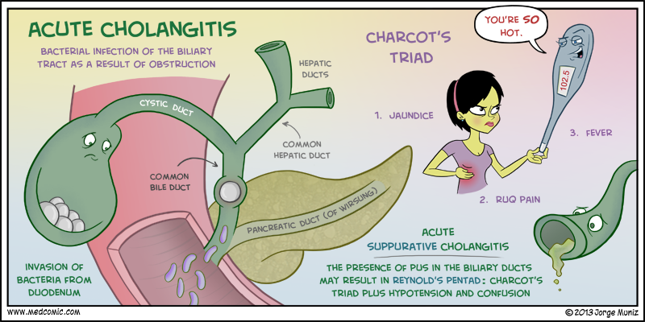
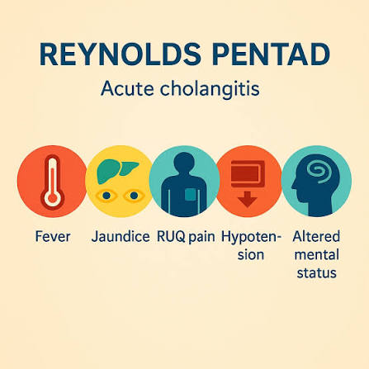
Biliary Disease: Ascending Cholangitis
Clinical Manifestations:
Symptoms: fever, chills, fatigue/malaise, rigors, abdominal pain, jaundice, pale stools (lack of bile)
CHARCOT’S TRIAD: fever with chills, RUQ pain, and Jaundice
REYNOLDS PENTAD: fever with chills, RUQ pain, Jaundice, Hypotension (shock), AMS
PE: fever, hypotension, RUQ Pain, Abdominal distention, AMS (WHY?)
YOU MUST KNOW THESE!

Slide 51
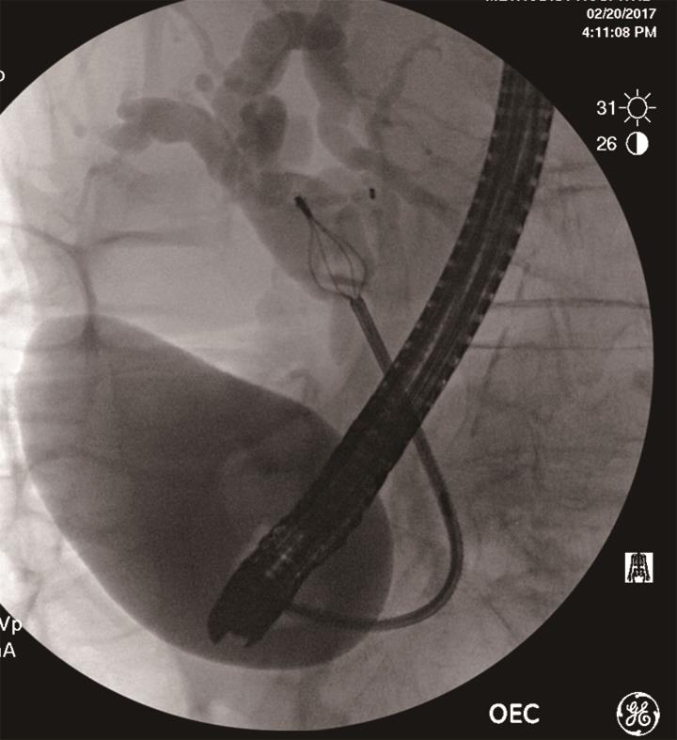
Biliary Disease: Ascending Cholangitis
Diagnostics:
CBC with diff: leukocytosis (with left shift)
CMP: elevated LFTs (cholestasis elevate ALP/GGT), hyperbilirubinemia (conjugated), elevated ammonia
Coagulation Studies: prolonged PT/PTT/INR
Lactic Acid, Procalcitonin
Blood cultures x 2
Abd (RUQ) US: initial test of choice – common bule duct dilation or stones, thickening of the bile duct walls, pyogenic material
Consider CT Scan if US non–conclusive
Cholangiography: GOLD Standard – ERCP (PTC – percutaneous transhepatic cholangiography can also be considered)

Slide 52
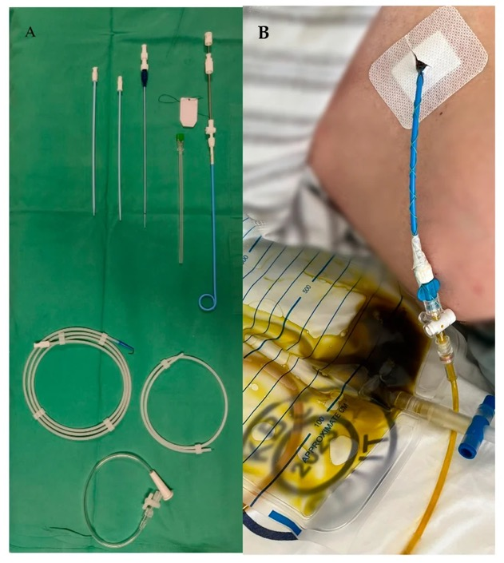
Biliary Disease: Ascending Cholangitis
Management:
Start IV Antibiotics (which ones?)
IVF, antiemetics
ERCP: endoscopic sphincterotomy with stone extraction and/or stent insertion for establishing biliary drainage in acute cholangitis
PCT (percutaneous cholecystostomy tube) - considered in patient who are unstable or can’t tolerate ERCP or ERCP not successful
Open Surgical Decompression + drain-tube insertion if other methods have failed

Slide 53
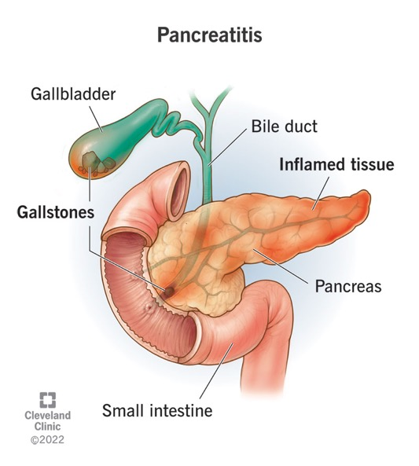
Acute Pancreatitis: Overview
Acute Pancreatitis: inflammation of the pancreas
Pathology caused by acinar cell injury leading to intracellular activation of the pancreatic enzymes causing autodigestion of the pancreas
Etiologies: Gallstones MC, alcohol abuse
Medications: Thiazides, Protease Inhibitors, Estrogens, Exenatide, Valproic Acid

Slide 54
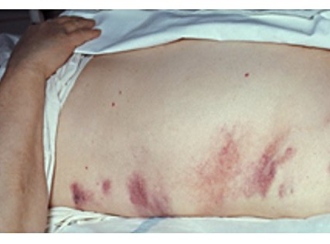
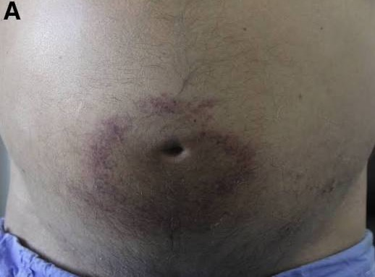
Acute Pancreatitis: Clinical Manifestations
Symptoms: epigastric pain that radiates to the back (or other quadrant) – pain can be exacerbated if supine and with eating. Relieved with leaning forward, sitting, and fetal position.
Fever, N/V, abdominal distention, SHOCK symptoms if severe.
Physical Exam: epigastric tenderness, tachycardia, abdominal distention, fever, dehydration, anorexia
Necrotizing (hemorrhagic): Cullen’s sign (periumbilical ecchymosis) and Grey Turner Sign (flank ecchymosis)

Slide 55

Acute Pancreatitis: Clinical Manifestations
Diagnostics:
Lipase/Amylase elevated 3x ULN (lipase more specific)
CBC with Diff (leukocytosis)
CMP: renal function (ALT 3x ULN – gallstone pancreatitis), liver function
Hypocalcemia: necrotic fat binds to calcium
Hyperglycemia (Why?)
Lactic acid/Procalcitonin
Radiology:
CT A/P w/Contrast: diagnostic of choice – enlarged pancreas, indistinct margins
Abd US: to assess for gallstones and bile duct dilation

Slide 56

Acute Pancreatitis: Clinical Manifestations
Diagnostic Criteria for Acute Pancreatitis:
Acute onset of sever epigastric pain (radiation to the back)
Elevation in serum lipase/amylase 3x ULN or greater
Characteristics of pancreatitis on imaging
Imaging may not be required based if patient meets first two criteria

Slide 57


Slide 58

Acute Pancreatitis: Management
“REST THE PANCREAS”
NPO!
IVF (aggressive hydration -10ml/kg bolus)/electrolytes
Pain Control (opioids etc.)
Insulin (WHY?)
Antiemetics (Zofran etc.)
Consider TPN (total parenteral nutrition)
Antibiotics are typically not needed unless infection also suspected
Advance diet as tolerated over the next 2-3 days
ERCP if indicated

Slide 59

Chronic Pancreatitis: Overview
Chronic Pancreatitis: progressive inflammatory changes to the pancreas leading to loss of endocrine/exocrine function
Etiologies: alcohol abuse MC, cystic fibrosis most common cause in children
Familial, gallstones, tumors, idiopathic
Signs/symptoms can take time to become apparent in patients with chronic pancreatitis

Slide 60


Chronic Pancreatitis: Clinical Manifestations
Symptoms: abdominal pain – epigastric/back pain, n/v, anorexia, steatorrhea (excess fat in stool – causes floating)
Diagnostics:
Amylase/Lipase may be normal, even low
CBC with diff
CMP: hyperglycemia
Consider cardiac (especially in what populations?)
CT A/P w/contrast: modality of choice – calcifications of the pancreas with dilated pancreatic or biliary ducts
Abd. X-ray: calcified pancreas
Classic Triad: Calcifications + Steatorrhea + DM

Slide 61


Chronic Pancreatitis: Management
Pain Control: NSAIDS, Tylenol
Lifestyle Modifications: no alcohol, low fat diet, vitamins
Pancreatic Enzyme Supplementation (Creon)
Pancreatitis – DMII (Metformin, Insulin etc.)
Complications: DM, Osteoporosis/Osteopenia, increased risk of adenocarcinoma
Always a risk for an acute flare – acute pancreatitis-like symptoms

Slide 62
Pancreatic Malignancies: Overview
Highly lethal malignancy: third leading cause of cancer related death in the U.S.
Five-year survival rate is 30% for node-negative and 10% for node positive patients
Histological Types: Exocrine Neoplasms
Adenocarcinomas: MC (85%) rising from the ductal epithelium (avg 6 month survival rate)
Ampullary/Duodenal Carcinoma
Cystadenoma/Cystocarcinoma: typically have a better prognosis overall
More inclusive term for most pancreatic malignancies is usually referred to as “exocrine” pancreatic neoplasms
60-70% of all pancreatic neoplasms occur in the head of the pancreas
Typically progresses from intraepithelial neoplasia (PanIN)

Slide 63

Pancreatic Malignancies: overview
Histological Types: Endocrine Neoplasms
Account for only about 5% of all pancreatic neoplasms
Referred to as Pancreatic Neuroendocrine Tumors (NETs)

Slide 64

PANCREATIC MALIGNANCIES: RISK FACTORS
Smoking Hx: twice as high for smokers
Obesity: BMI>30 (increased risk by 20%)
Diabetes: reason not fully understood
Hx of Chronic Pancreatitis
Men slightly more at risk than women
Family hx of pancreatic cancer

Slide 65

Pancreatic Malignancies: Clinical Manifestations
Symptoms Include:
Asthenia (abnormal weakness)
Weight Loss
Anorexia
Abdominal Pain
Epigastric Pain
Dark Urine (can be first sign of jaundice)
Nausea
Back Pain
Diarrhea
Vomiting
Steatorrhea

Slide 66


PANCREATIC MALIGNANCIES: CLINICAL MANIFESTATIONS
Clinical Signs:
Jaundice (55%) – “Painless Jaundice”
Hepatomegaly (39%)
RUQ Mass
Cachexia (wasting)
Courvoisier's sign ( nontender but palpable distended gallbladder at the right costal margin )
Epigastric Mass
Ascites

Slide 67


Pancreatic Malignancies: Clinical Manifestations
Clinical Signs: Associated with Metastasis
Abdominal mass: late finding
Abdominal Ascites
Left Supraclavicular Lymphadenopathy (Virchow’s node)
Palpable periumbilical mass (Sister Mary Joseph’s Node)
Migratory Thrombophlebitis (Trousseau syndrome)
Most common sites of metastatic disease include the liver, peritoneum, lungs, and less frequently, bone

Slide 68

Pancreatic Malignancies: Diagnostics
Patients who present with jaundice, epigastric pain, and weight loss will initially start with an US:
Abd US: to rule out masses, possible bile duct obstruction, or liver abnormalities
CT scan w/contrast: best initial diagnostic of choice in patients (also r/o pancreatitis)

Slide 69


Pancreatic Malignancies: diagnostics
Endoscopic Retrograde Cholangiopancreatography (ERCP)
usually diagnostic and therapeutic as well

Slide 70

Pancreatic Malignancies: Diagnostics
Other diagnostic tools:
Magnetic resonance cholangiopancreatography (MRCP): alternative to ERCP, doesn’t require contrast material to be injected into ductal system (less morbidity associated with contrast administration)
Tumor Markers: CA19-9
Specificity and Sensitivity isn’t the best for pancreatic cancer
Can also be elevated in other benign disorders of the hepatobiliary system
Often used for staging and postoperative evaluation

Slide 71

Pancreatic Malignancies: Diagnostics
Biopsy is required to confirm the diagnosis!
Percutaneous biopsy (FNA) either US or CT guided: although can be done with small tumors, there is a risk of spreading cells during procedure, thus making surgery less effective
Endoscopic US Guided Biopsy (EUS Guided FNA): best modality for obtaining sample of suspected tissue

Slide 72

Pancreatic Malignancies: Staging
Staging typically uses the TNM system
CT scan/PET scan usually indicated to determine metastasis
Most patient who present with symptoms related to pancreatic cancer have advanced disease, often with mets
Staging very important in determining whether the tumor is resectable or not

Slide 73

Pancreatic Malignancies: Treatment
Treatment determined by how advanced the tumor is and whether there is evidence of metastasis
If the tumor is confined to head/duodenal region of the pancreas, the usual first treatment, WHIPPLE PROCEDURE! (pancreaticoduodenectomy)
Avg 5-year survival rate s/p Whipple is about 20-25%

Slide 74

Pancreatic Malignancies: Treatment
https://www.youtube.com/watch?v=4Zxvm3MSb8k

Slide 75

Pancreatic Malignancies: Treatment
Surgery can also be performed in some cases
Tail end tumors: distal pancreatectomy
Total Pancreatectomy: requires patients to be on insulin/enzyme replacement for the rest of their lives
Blood vessel resection if there is active tumor involvement
If surgery is not applicable, patient will then require systemic chemotherapy +/- radiation

Slide 76

Pancreatic Malignancies: Treatment
For patients who are not surgical candidates, usually undergo chemotherapy/radiation treatments
Approximately 40% of patients with pancreatic cancer present with unresectable tumors
Treatment is going to depend on staging and how advanced tumor involvement is
Systemic chemotherapy indicated if distance metastasis has already occurred
A lot of patient opt for clinical trials since the commonly used therapies have not had long term success
Some patients successfully become surgical candidates after chemotherapy has been initiated due to reduction in tumor size (patients who are deemed borderline resectable)

